Slide 1




Chapter 1 - Context
Chapter 2 – Literature Review
Chapter 5
System Integration
Chapter 4
Automatic Retrieval
Chapter 3
Information Needs

Slide 2
Social Media
NLP
for
Social Media
Social Media
for
Crisis
NLP
NLP
for
Crisis
Crisis
Scope of this manuscript

Slide 3
National crisis cell
Response Teams
Information processing & mngt.
Information System
Management lvls
Regional crisis cell
Decision makers
Operators
Rescue managers
External sources of information
Rescue operators
Local crisis cell
Information flow

Slide 4
Hub
Community

Slide 5
Danger
Risks
Stakes
Consequence
Event

Slide 6









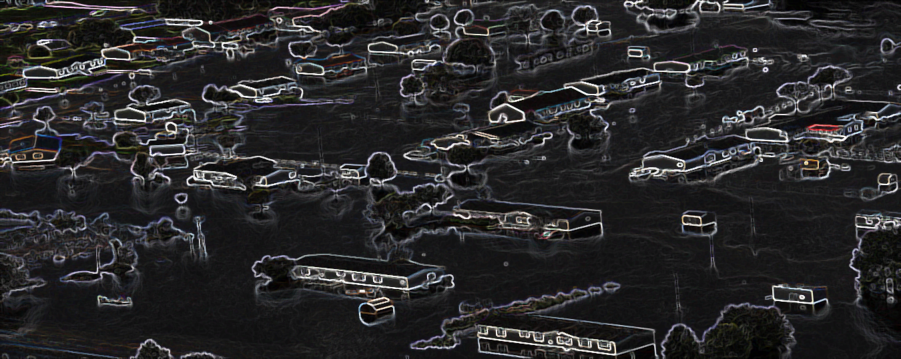






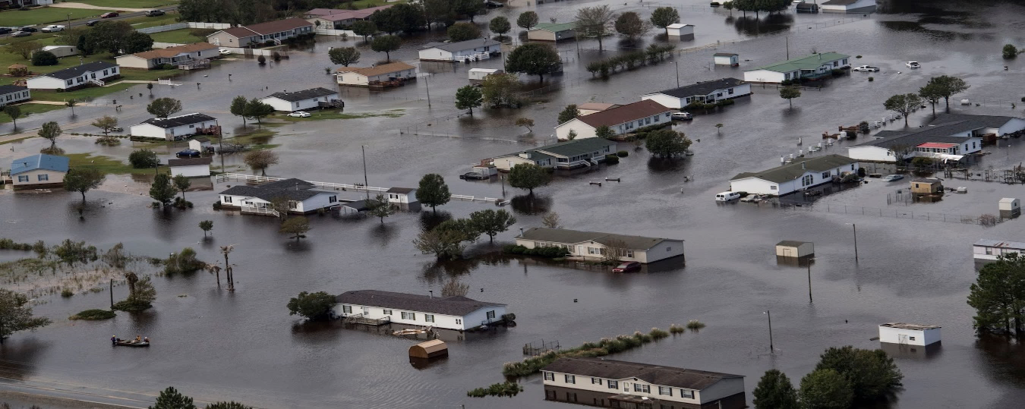




Information System
Call takers/SM Operators
Metamodel
Decision Makers
Common Operational Picture
Data flow
Decisions

Slide 7
Information System
Call takers/SM Operators
Metamodel
Decision Makers
Common Operational Picture
Data flow
Decisions
Scope of this chapter

Slide 8



Information System
Call takers/SM Operators
Metamodel
Decision Makers
Common Operational Picture
Data flow
Information Required
Decisions

Slide 9
Social sciences
Chapter 3
Information needs
Information sciences
Chapter 5 Information organization
System
Algorithm
Chapter 4
Information collection

Slide 10
COZ
Préfet (decision maker)
Firefighter representative
Police representative
Infrastructure representative
Other functions
Communication team
ZONAL Level
COD
Préfecture départemental
SDIS
Police, Gendarmerie
Météo France
CTA
CODIS
Coordination
Operational center Fire and Rescue
Law enforcement
Weather forecast
Calls processing
EMS
DDT
Rescue, Medical care
Rescue
Road infrastructure
DÉPARTEMENTAL Level
PCC
CIS
Communal Command Center
Fire station
Rescue, Medical care
Coordination
Legend
COMMUNAL Level
Information
flow
Order
Field
Intervention

Slide 11
SDIS 83
Emergency Response Command
Call takers
CODIS
Dispatch and coordination of deployed rescue teams
MSGU Cell
Information
Report
Simulation Cell (+ VISOV)
Order
Provides inputs for the different actors according to the exercice plan

Slide 12
Préfecture Vienne
Representatives:
Firefighters
Police
Infrastructure
COD
Communication Cell
VISOV
Dispatch information and coordination the different services
Simulation Cell
Provides inputs for the different actors according to the exercise plan
Information
Report
Order

Slide 13
COZ SO
Representatives:
Firefighters
Police
Infrastructure
COZ
Communication Cell
VISOV
Dispatch information and coordination the different services
COD
COD
COD
Simulation Cell
Provides inputs for the different actors according to the exercise plan
Information
Report
Order

Slide 14
Information
Organization
Situational Awareness
Actionable
Event
Environment conditions
Actors already involved
Responders’ needs
Resources available
Location
Credible
Context
Right role
Timely

Slide 15
SITUATION AWARENESS
Actionable Information
State of the
Environment
Perception of the Elements of the current Event
Comprehension of the current Event
Projection of future state
Decision
Level 1
Level 2
Level 3
Collection
Interpretation
Analysis
Data
Information
Knowledge
Decision

Slide 16







Legend
EMS
Police
Firefighters
Event
Time
t1
t1
t1
t1
Event Location
Event Context
Environ.
Respon.
Needs
Resources

Slide 17

Call takers/SM Operators
2
3
Common Operational Picture
1
Decision Makers
Chapter order
Data flow
Decisions
Information Required

Slide 18
Call takers/SM Operators
Common Operational Picture
Decision Makers
Data flow
Decisions
Information Required

Slide 19
Call takers/SM Operators
Common Operational Picture
Decision Makers
Data flow
Decisions
Information Required

Slide 20
Call takers/SM Operators
Common Operational Picture
Decision Makers
Data flow
Decisions
Information Required

Slide 21



Informativeness
Eyewitness
Summary
Data Collection
Preprocessing
Processing
Call takers
SM Operators
Decision Makers

Slide 22


Previous Work
Contribution
Informativeness
Eyewitness
Summary
Data Collection
Entity Recognition
Information Model
Preprocessing
Processing
Call takers
SM Operators
Decision Makers

Slide 23

Language Model
Cops
Cops
Firefighters
BERT
Firefighters
Dimension reduction
Starfish
Firefighter
House
Starfish
0.1286, 1.5432
1.5438,-1,987
-1.8437, 0.1093
Roof
Starfish
UMAP
House
Roof
House
Flood
Fire
Flood
Fire
Clustering
HDBSCAN
Cops
Cops
Firefighters
Firefighters
Starfish
Roof
Starfish
House
Roof
Label Propagation
House
Flood
Flood
Fire
Fire

Slide 24
Event
location: Location
type: str
cause: str
severity: str
other: str
Environment
Actors Involved
Actors Needs
Resources Available
area details: str
population density: int
hazards: Hazard
other: str
professionals: Actors
civilians: Actors
resources: Equipment
other: str
actors: Actors
equipment: Equipment
casualties: int
other: str
actors: Actors
equipment: Equipment
other: str
Location
Hazard
Equipment
Actors
indication: str
address: int
type: str
location: Location
type: str
quantity: int
qualification: str
staffing: int

Slide 25











Slide 26
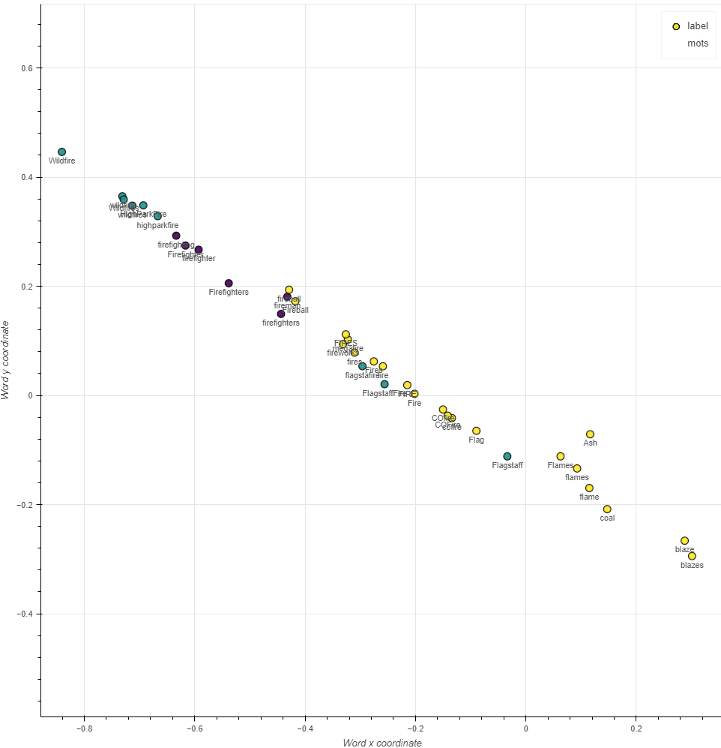
Event
Actors
Hazard

Slide 27
Information System
Call takers/SM Operators
Metamodel
Decision Makers
Common Operational Picture
Data flow
Decisions
Scope of this chapter

Slide 28

2. Preprocessing
1. Collection
3. Processing
Storage
Call takers
SM Operators
Decision Makers

Slide 29
Model Development
Objective Definition
Data Collection & Preparation
Feature Engineering
Model training
Model Evaluation
Model Maintenance
Model Monitoring
Model Deployment
Model Preparation
Model Serving
Machine learning engineering

Slide 30




Data System
Sensors
outputs
Raw data
Clean data
Clean data
Data Collection
Data Processing
Data Storage
Data Distribution
Model Development
Unlabeled
data
Users Interactions
Model Serving
Models Performances
Labeled data
Machine Learning Lifecycle
Predictions
Information Distribution
Information Storage
Information Processing
Information Collection
Organized inf.
Organized inf.
Unorganized inf.
Informative reports
Information System

Slide 31




Client Interface
Event Broker
7
6
reads predictions
Output thread
sends predictions
Model serving – Interp. Engine
sends requests
Input thread
reads requests
Social Media Operator
1
2
5
Model ready thread
gets model
ready
sends model ready
Client Interface
4
Model training- Interp. Engine
sends labeled data
Labeled data thread
reads labeled data
2
3
Labeler

